Slide 1

Web Tables, Utilities,Properties
Lesson - 12
Orion Innovation
Company Overview

Slide 2
Previous Lesson’s Highlights
Alerts
1) // To click on the ‘Cancel’ button of the alert.
driver.switchTo().alert().dismiss();
2) // To click on the ‘OK’ button of the alert.
driver.switchTo().alert().accept();
3) // To capture the alert message.
driver.switchTo().alert().getText();
4) // To send some data to alert box.
driver.switchTo().alert().sendKeys("Text");
iFrames
driver.switchTo().frame(0);
driver.switchTo().frame("id of the element");
driver.switchTo().frame(“name of the element");
Source: [2] Handle the iFrames
Source: [1] Handle the Alerts
Windows
String mainWindowHandle = driver.getWindowHandle();
Set<String> allWindowHandles = driver.getWindowHandles();
driver.switchTo().window(ChildWindow);
Source: [3] Handle the Windows

Slide 3
Content
Web Tables
Utilities
Properties

Slide 4
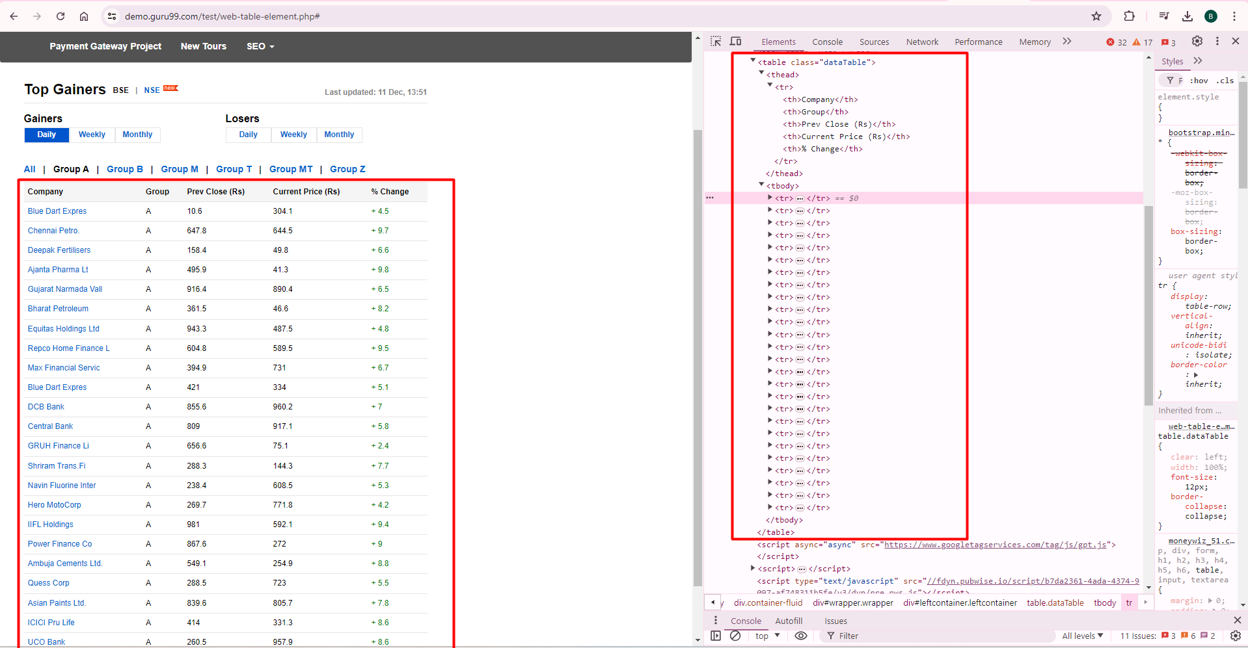
Web Tables
Web Tables are similar to normal tables where the data is presented in a structured form using rows and columns.
Source: [4] Example of Web Table

Slide 5
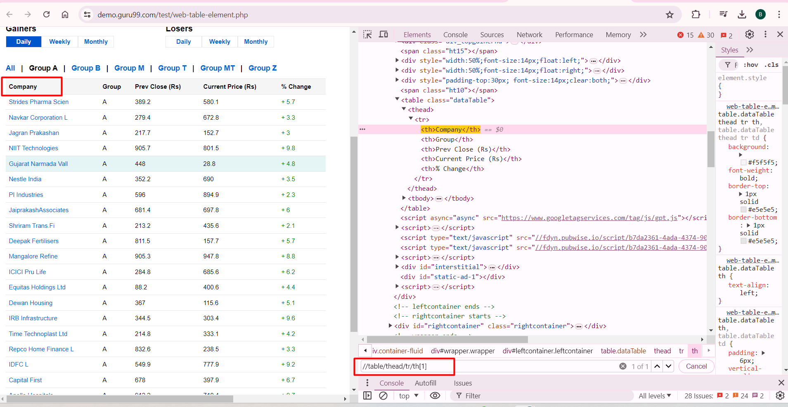
Web Tables
Source: [4] How to locate the Web Table?

Slide 6
Web Tables
table: parent tag
- thead: represents column headings
- tbody: represents table body
- tr: represents table row
- td: represents cell data
Types of Web Tables:
Static tables: Data is static i.e. Number of rows and columns are fixed.
Dynamic tables: Data is dynamic i.e. Number of rows and columns are NOT fixed.

Slide 7
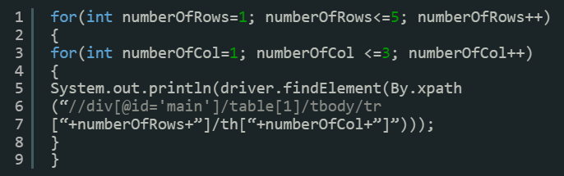
How to Handle Web Tables?
Approach #1:
Below is the xpath of one of the cells in html table. Let’s say “firstname”
//div[@id=’main’]/table[1]/tbody/tr[1]/th[1]
tr[1] defines first row and th[1] defines the first column.
If several rows and columns are always constant, our HTML table will always have 5 rows and 3 columns.
Except for row and column numbers, each component of XPath remains the same. So you can iterate using “for loop” for each row and column as mentioned above.
Source: [5] How to handle Web Tables?

Slide 8
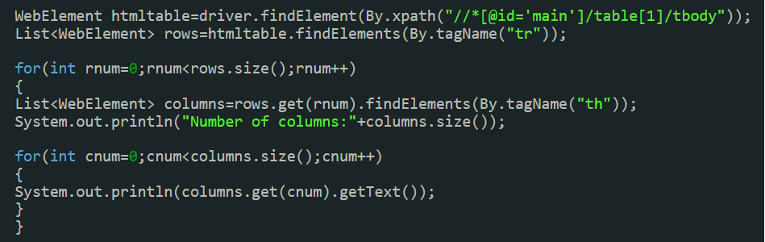
How to Handle Web Tables?
Approach #2:
Step #1: First get the entire HTML table and store this in a variable ‘htmltable’ of type web element.
Step #2: Get all the rows with the tag name ‘tr’ and store all the elements in a list of web elements. Now all the elements with the tag ‘tr’ are stored in the ‘rows’ list.
Step #3: Loop through each row and get the list of elements with tag ‘th’. ‘rows.get(0)’ will give the first row and ‘findElements(By.tagName(“th”))’ will give a list of columns for the row.
Step #4: Iterate using ‘columns.getsize()’ and get the details of each cell.
Note: The above approach will be most suitable if the table dimensions change dynamically.
Source: [5] How to handle Web Tables?

Slide 9
Utilities
Utility classes are essential for keeping your test scripts clean and reusable. They encapsulate common operations and can be used across multiple test cases.
Types of Utilities
Browser Utilities
Wait Utilities
File Utilities
Screenshot Utilities
Source: [6] Chat GPT

Slide 10
Properties
Properties files are used to store configuration data such as URLs, browser types, and credentials. This allows for easy management and modification of configurations without changing the code.
Example Properties File (config.properties):
url=https://example.com
browser=chrome
username=testuser
password=testpass
Source: [6] Chat GPT

Slide 11
Homework – Web Tables
Create a class named Lesson12_WebtablesHomework.
Navigate to the page https://demoqa.com/webtables.
Print the header of the 5rd column.Print all the data from the table.Print the total number of cells (data) in the table.
Print the number of rows in the table.Print the number of columns in the table.
Print the names of the departments listed in the headers.
Print the data from the 2rd column for the person whose "First Name" is Alden.

Slide 12
References
[1] https://www.guru99.com/alert-popup-handling-selenium.html
[2] https://www.guru99.com/handling-iframes-selenium.html/
[3] https://toolsqa.com/selenium-webdriver/window-handle-in-selenium/
[4] https://demo.guru99.com/test/web-table-element.php#
[5] https://www.softwaretestinghelp.com/selenium-tutorial-18/
[6] https://chatgpt.com/

Slide 13
Thanks

